Slide 1
CRC Cards
Class-Responsibility-Collaboration

Slide 2

Where did the idea come from?
Kent Beck and Ward Cunningham first introduced CRC cards at OOPSLA (object-oriented programming systems, languages and applications. )’89 in their paper "A Laboratory for Teaching Object-Oriented Thinking". Originally their purpose was to teach programmers the object-oriented paradigm.

Slide 3
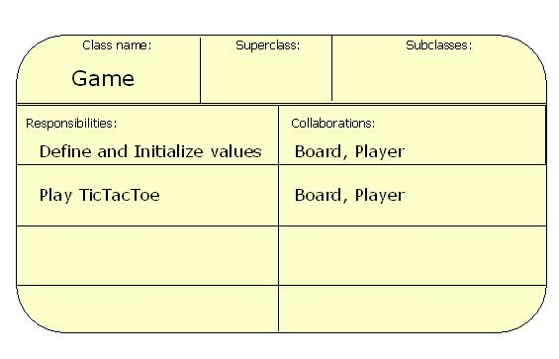
What?
CRC Card Contents
The class name
Class responsibilities
Names of other classes that the class will collaborate with to fulfill its responsibilities

Slide 4


Why?
Are they even useful?

Slide 5

Why?
Are they even useful?
Gives people a good “feel” for how aspects of the program will work together

Slide 6
Why?
Are they even useful?
Gives people a good “feel” for how aspects of the program will work together
Allowing people to propose and test changes to the design rapidly (all you have to do is make new cards)

Slide 7
Why?
Are they even useful?
Gives people a good “feel” for how aspects of the program will work together
Allowing people to propose and test changes to the design rapidly (all you have to do is make new cards)
Focus on responsibilities as opposed to attributes

Slide 8
Summary
CRC cards are useful when trying to lay out product design and how classes will work with other classes and interfaces in the way that you want them to. With everyone communicating this would try to prevent…

Slide 9
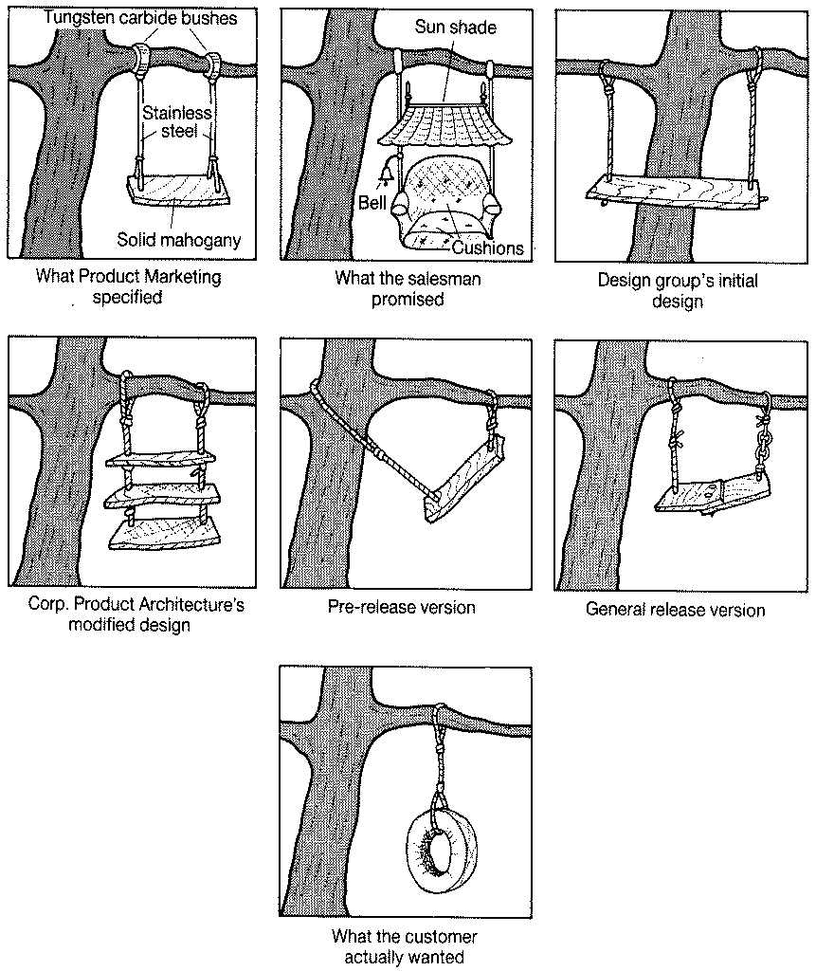

Slide 10
References
“CRC Cards”. http://ootips.org/crc-cards.html
“Introduction to CRC cards”. http://www.softstar-inc.com/Methodology/CRCIntro.htm
"A Laboratory for Teaching Object-Oriented Thinking“. Kent Beck, Ward Cunningham http://undergraduate.csse.uwa.edu.au/units/230.124/resources/crc/crc.html
“Using CRC cards”. http://alistair.cockburn.us/index.php/Using_CRC_cards

